Slide 1
PP7: X linked Inheritance, Co and incomplete dominance, Mutations and Mutagens
Year 10 Science

Slide 2
Other types of inheritance
We have looked at many traits that follow a simple dominant – recessive pattern
Many traits do not follow this pattern;
Polygenic inheritance
Co-Dominance
Incomplete Dominance
X-Linked inheritance

Slide 3

Polygenic Inheritance
Some traits do no have two simple alternatives, like freckles/no freckles
Some have many variations of the trait, such as human height or skin color
Traits such as these are under the control of many genes - polygenic

Slide 4
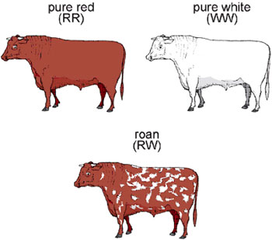
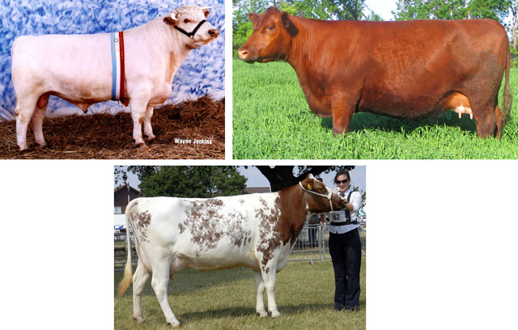
Co-Dominance
Both alleles are equally expressed – one is not more dominant over the other
Examples
Human blood group, if you get A from mum and B from Dad, child will be AB
Red haired cow and white haired bull, calves will be “Roan” which is a mixture of some white hairs and some red hairs

Slide 5
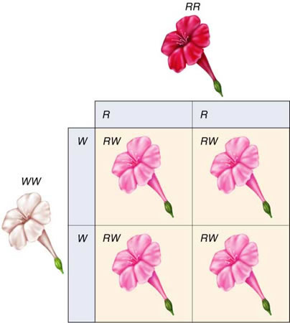
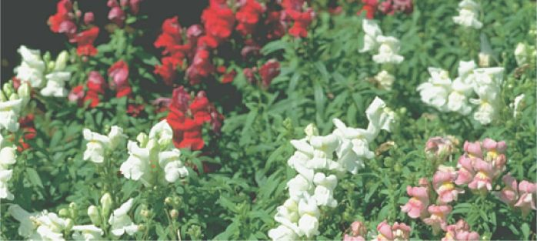
Incomplete Dominance
Where neither trait masks that other, and the offspring end up half way in between
Examples:
Snapdragon flowers
Red flowers crossed with white flowers, result in pink flowers

Slide 6
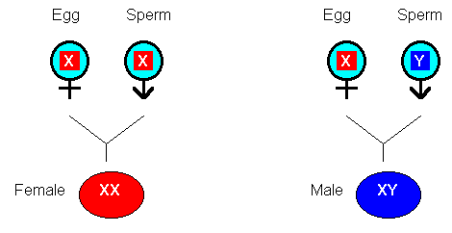
Sex Chromosomes
Females have two X chromosomes
Therefore all of her eggs contain one X chromosome as they are haploid
Males have one X and one Y chromosomes
Half his sperm will carry an X and the other half will carry a Y
So it is the sperm that determines the sex of children

Slide 7

Sex linked inheritance
Sometimes genes for certain diseases can be carried on either of the sex chromosomes. This is referred to as a sex linked condition
There is only one disease that is carried on the Y chromosome
If the father has it – all his boys will have it
Hairy ear syndrome

Slide 8
Sex linked – same as X linked
It is far more common that the X chromosome may carry a sex linked disease
These traits are far more common in males than females
This is because, if a male has a faulty X, he will show the disease
Girls may need to have two faulty X’s to show the disease.
If females have the faulty genes on one of their two X chromosomes, they only show the trait if it is a sex linked dominant trait. If it is a recessive trait, then they are called carriers
Boys get these diseases from their mothers (X)

Slide 9
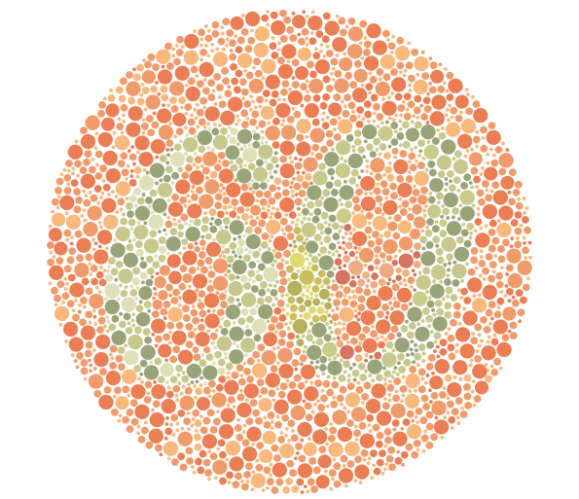
Color blindness – what do you see?

Slide 10
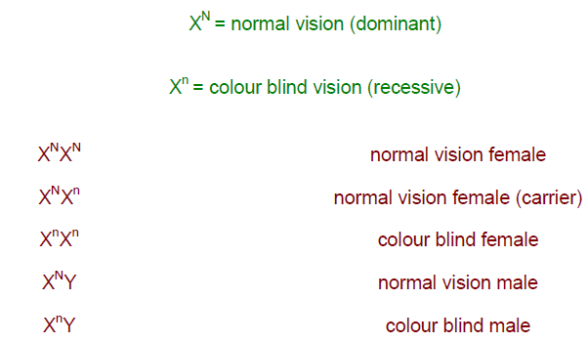
Genotypes and Phenotypes

Slide 11
Haemophilia
Disease where a particular protein necessary for clotting blood is not made
Patients can bleed to death from little injuries as their blood does not clot
Far more common in males
Sometimes called “The Royal Disease” as it is prevalent in the British Royal Family

Slide 12
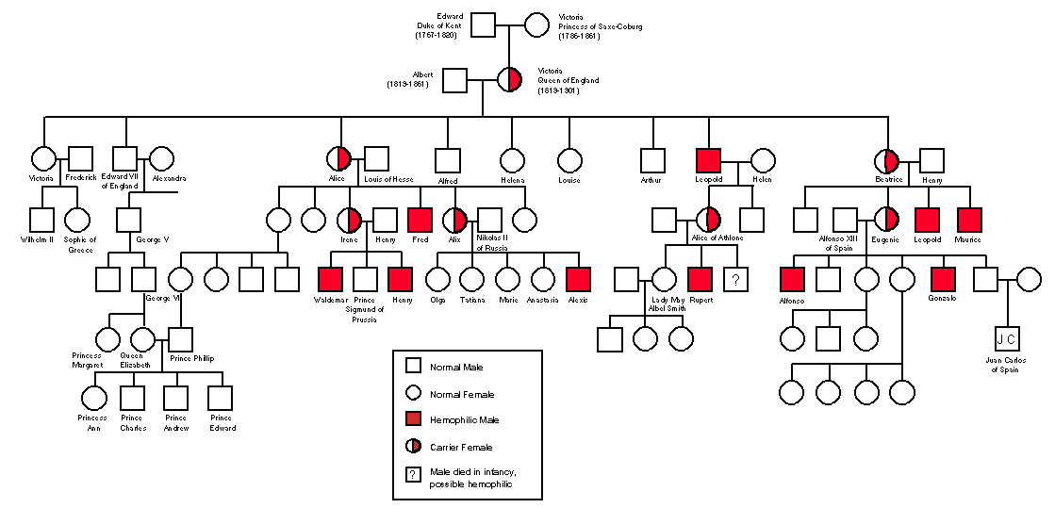

Slide 13
Genetic Mutations – when the code goes wrong
There are many reasons for genetic mutations
Some mutations can be only in one individual and are caused by damage to their DNA
Some can be inherited Eg color blindness
Some can affect a particular section of DNA, altering the function of one or more genes
Some can affect entire chromosomes
Some mutations happen spontaneously, and some are caused by mutagens

Slide 14
Mutagens
A mutagen is a substance that can cause mutations
Examples of mutagens are;
Some drugs
Certain chemicals
UV light
Radiation
X-Rays

Slide 15
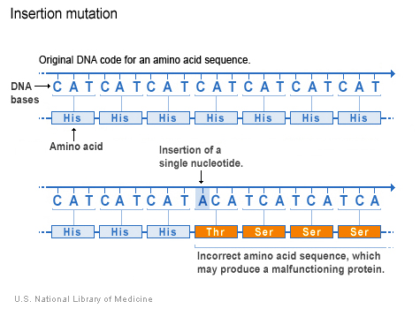
DNA Mutation
If the “code” is altered, a malfunctioning protein can result (Eg: Haemophilia)
Bases may be inserted, deleted, switched around, duplicated

Slide 16
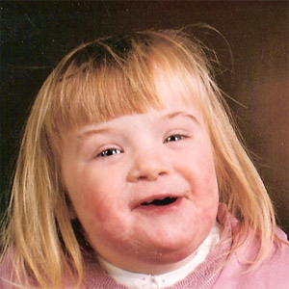
Chromosome mutations
Some genetic abnormalities result from extra or missing chromosomes
For example Down Syndrome
sufferers have an extra 21st
chromosome (trisomy 21)
Distinctive physical features
and mental retardation

Slide 17
Maternal Age
The risk of having a child with Down Syndrome increases dramatically the older the mother is when she falls pregnant
This is because her eggs were produced when she herself was an embryo, so the longer they “sit” before they are used, the greater the risk that something can go wrong

Slide 18
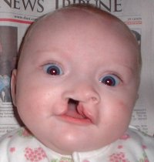
Cleft Lip

Slide 19
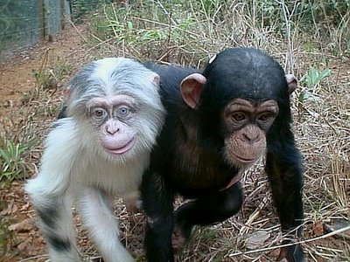
Albino

Slide 20
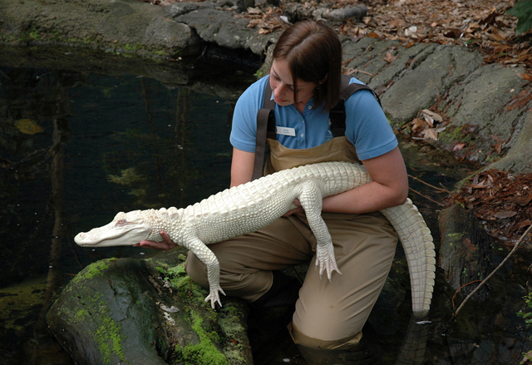
Albino

Slide 21
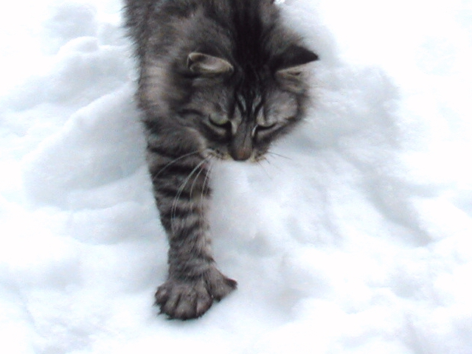
Polydactylism

Slide 22
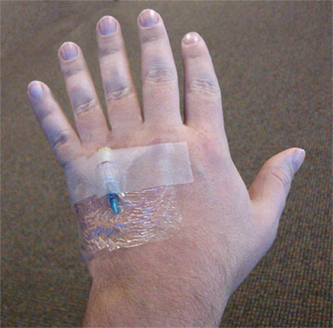
Polydactylism

Slide 23
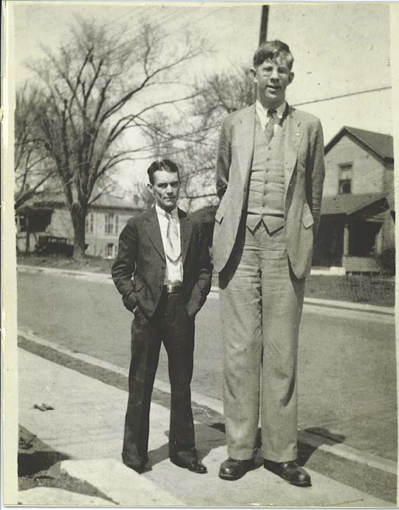
Hyper- thyroidism

Slide 24
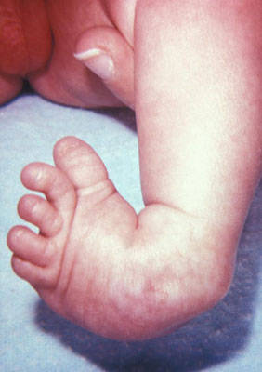
Club Foot

Slide 25
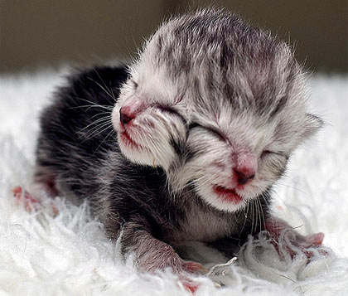
Two headed kitten
Something went
wrong during
embryonic
development

Slide 26
Activity
“Genetic Disorder Research Project”
Read through the information on a variety of genetic disorders, choose one that interests you and let me know which one you have chosen.
Make a start on the assignment.
This is an assessable Homework task, and is due in next week.

